Slide 1
Automobile Sales
Timothy Munson
Sajan Khadka

Slide 2
Contributions
Sajan Khadka: ER diagram, relational diagram, queries
Timothy Munson: database design, implementing interfaces

Slide 3
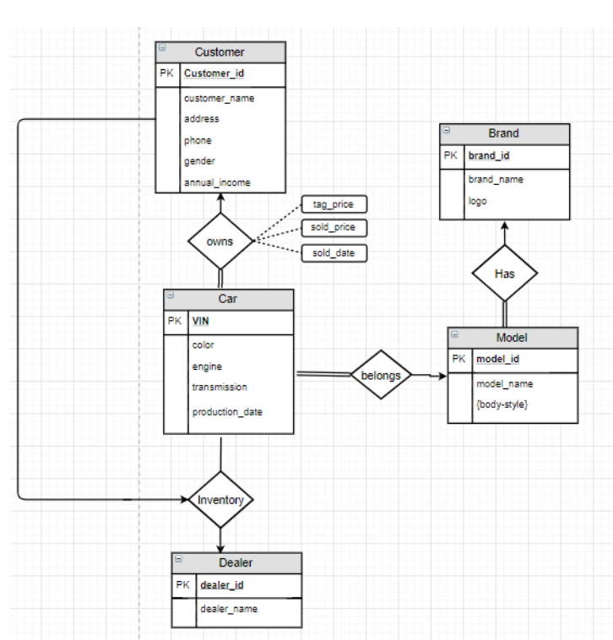
ER Diagram

Slide 4
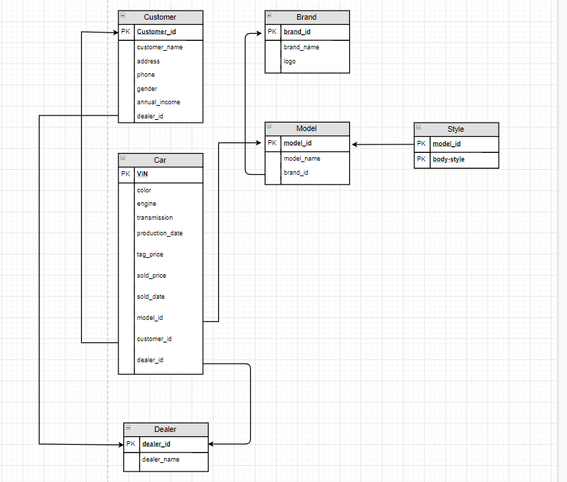
Relational Diagram

Slide 5
Let’s see how the application works

